Slide 1
Manipulators
CSCE 121
J. Michael Moore
Strongly influenced by slides created by Bjarne Stroustrup and Jennifer Welch

Slide 2
Manipulators
Modify the state of a stream
Most manipulators are “sticky.”
They are set and are permanent until changed again.
http://www.cplusplus.com/reference/library/manipulators/

Slide 3
Integer Formatting
Recall
Decimal (base 10: digits 0-9)
Octal (base 8: digits 0-7)
Hexadecimal (base 16: digits 0-9, a-f)
Indicate which base an input or output stream should use:
dec, oct, or hex
sticky

Slide 4
Integer Formatting Examples
int x = 1234;
cout << hex;
// from now on, ints will be written to screen in hex:
cout << x;
cin >> oct;
// from now on, ints will be read in from keyboard as
// if they are in octal
int y;
cin >> y;
cout << dec; // back to decimal output
cin >> dec; // back to decimal input

Slide 5
Floating Point Formatting
scientific: one digit before decimal point, n digits after decimal point, plus exponent
Ex: 1.2345678e+03
use manipulator scientific
fixed: n digits after decimal point, no exponent
Ex: 1234.567890
use manipulator fixed
n is the “precision” (coming up next)

Slide 6
Precision
If not set to scientific or fixed, precision is the number of digits
For scientific, precision is number of digits after decimal point
For fixed, precision is number of digits after decimal point
Use setprecision manipulator (for output streams)
Ex: cout << scientific << setprecision(8);

Slide 7
Width
You can control the width (number of characters to be used for the output)
not sticky
output is never truncated to fit
All this is the kind of stuff you look up when you need it

Slide 8
Stream States
CSCE 121
J. Michael Moore
Based on slides created by Carlos Soto.

Slide 9
Stream State
State refers to the overall configuration of information.
When you change a variable’s value, you change the state…
OR not – sometimes the value of a variable does not alter what you would do!

Slide 10
What is the state of a stream?
Good
Location in file
End of File
Bad
Problems with the stream itself
Internet goes down
Printer loses power
Any kind of crash or break
Input is not what is expected (Logical)
Looking for an int got a ‘z’
Recall that all data in the files will be characters.
Built in functions to convert strings to numbers, etc.

Slide 11
Robustness
Recall that we want our programs to be robust.
i.e. they should not crash with unexpected input!
Streams store state information in flags (i.e. bits)
We can use stream state information to recover gracefully when there are problems with streams.

Slide 12
Stream State Flags
Flag | Meaning
goodbit | Everything is OK
eofbit | Reached end of a file
badbit | Something is wrong with stream
failbit | Stream used incorrectly
http://www.cplusplus.com/reference/ios/ios_base/iostate/

Slide 13

Stream State Functions
Function | eofbit | failbit | badbit
good()
eof()
bad()
fail()
none of the bits set i.e. zero

Slide 14
Input Validation
CSCE 121
J. Michael Moore
Based on slides created by Carlos Soto.

Slide 15
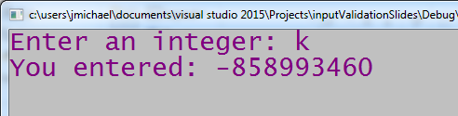
Using Stream State to Validate Input
cout << "Enter an integer: ";
int val;
cin >> val;
cout << "You entered: " << val << endl;
Failbit is set.
So, we can catch this and ask until we get a number.

Slide 16
Using Stream State to Validate Input
cout << "Enter an integer: ";
int val;
cin >> val;
while(!cin.good()) { // any of the stream state bits is set
cin.clear(); // set all stream state bits to zero, buffer NOT cleared
cin.ignore(numeric_limits<streamsize>::max(), '\n');
// clear the buffer of everything, i.e. make clean slate for input
cout << "Enter a valid integer: ";
cin >> val;
}
cout << "You entered: " << val << endl;

Slide 17
Checking for errors in our input
cin.clear();
Clear stream states
Does NOT affect buffer
cin.ignore(numeric_limits<streamsize>::max(), '\n');
First parameter – max number of characters to ignore (i.e. remove from buffer)
Second parameter – character to stop ignoring characters
numeric_limts – different streams have different sizes, using this ensures that if the buffer is completely full, it will remove all of it.
'\n' – character representing end of line.
Since end of line is a non-printing character we use the ‘\’ to indicate a character that is not the \.
\n designates then end of line in C++.

Slide 18
Functions Overview
CSCE 121
J. Michael Moore
Strongly influenced by slides created by Bjarne Stroustrup and Jennifer Welch

Slide 19
Spaghetti Code
Code can become cumbersome/long.
What to do?
Break it up into parts / subroutines
A subroutine is a piece of code that accomplishes a task.
When the task returns a value it is like a function.
But not all subroutines need to return a value…

Slide 20
Functions (i.e. C++ Subroutines)
A named sequence of statements
Can return a result
Standard library provides lots of functions
We can write our own functions also

Slide 21
Recall Programming Goals
Correctness
Efficiency
Robustness
Readability
Reuse
Modularity

Slide 22
Benefits of Functions
Correctness, Modularity
Chop a program into manageable parts
Divide and conquer
Model problem domain
Name logical operations
A function should do one thing well
Improves readability of program
Can be useful in many places in program
Avoid having to copy same code
Ease testing, maintenance, division of labor
Modularity, Robustness
Readability
Reuse, Correctness, Robustness
Correctness, Robustness
Zybooks: Reasons for defining functions…

Slide 23
Rules of Thumb
Keep functions small (about one screen)
Each function should do a single well-defined task
Makes them easier to understand, specify, and debug

Slide 24
Anatomy of a Function Part 1
CSCE 121
J. Michael Moore

Slide 25
Declaring and Defining a Function
General form:
return_type name (formal arguments); // declaration
return_type name (formal arguments) body // definition
Formal arguments (also called parameters), format is
type1 name1, type2 name2, …
Make return type void if you don’t want to return anything
body is a block (or a try block)
Example: double f(int a, double d) { return a*d; }

Slide 26
Calling a Function
Recall: double f(int a, double d) { return a*d; }
To call a function: name (actual arguments)
Actual arguments format is
argname1, argname2, …
do not include types!
Example:
int x = 2;
double y = 5.0;
cout << f(x,y); // prints out 10.0

Slide 27
Note on Terminology
Definition | Stroustrup | zyBooks | Other Possibilities
In the declaration/definition, the type and names of values to be passed into the function. | Formal Argument | Parameter | Formal Parameter
In the call, the values/variable actually passed into the function. | Actual Argument | Argument | Actual Parameter

Slide 28
Function Placement
Functions must be declared in the .cpp file before they are called.
So if a function is called in the main function, then it must be declared before main.
You cannot define functions inside other functions
We’ll talk about defining functions inside classes later

Slide 29


Function Placement
#include <iostream>
using namespace std;
int main() {
cout << times(7, 2);
}
int times(int a, int b) {
return a*b;
}
#include <iostream>
using namespace std;
int times(int a, int b) {
return a*b;
}
int main() {
cout << times(7, 2);
}

Slide 30
Function Prototype (Alternative)
#include <iostream>
using namespace std;
int main() {
cout << times(7, 2);
}
int times(int a, int b) {
return a*b;
}
#include <iostream>
using namespace std;
int times(int, int);`
int main() {
cout << times(7, 2);
}
int times(int a, int b) {
return a*b;
}

Slide 31
How Functions Work Part 1
CSCE 121
J. Michael Moore

Slide 32
Stack Frames and Function Calls
Function Called (including main)
New area of memory (stack frame) is set up on top of the stack.
Stack frame has an entry for
each formal parameter
each local variable
Body of function executes
Function finishes and its stack frame goes away
i.e. memory is recycled for later use
Potential source of programming bugs if you don’t understand how this works!
Strongly influenced by slides created by Bjarne Stroustrup and Jennifer Welch

Slide 33
Stack Frame
Contains
Parameters
Value of actual argument is copied into corresponding formal argument variable in stack frame
Order matches the order in both argument lists: 1st to 1st, 2nd to 2nd, etc.
So the function computes using the formal argument
No change is made to the actual argument
Local variables
Information for returning to the calling function
E.g. address in code of calling function to go back to

Slide 34
Memory Diagram
Helps us visualize the call stack
zyBooks starts at top since addressing is considered to start at zero and frequently drawn with zero at the top.
However, when talking about stacking, we put things on top!
So we will start at the bottom so that when we put a stack frame on top, it looks like it is going on top.
When we draw a stack frame, we’ll include information about
Parameters
Local variables
Name of function

Slide 35
Program
output
int em(int a, int b) {
int k = 3;
int whoop = a + b + k;
return whoop;
}
int gig(int rev) {
int howdy = 4;
return em(rev, howdy);
}
int main() {
int b = gig(em(1, 6));
cout << "b: " << b << endl;
}
identifier
stack

Slide 36
Program
output
int em(int a, int b) {
int k = 3;
int whoop = a + b + k;
return whoop;
}
int gig(int rev) {
int howdy = 4;
return em(rev, howdy);
}
int main() {
int b = gig(em(1, 6));
cout << "b: " << b << endl;
}
main
b
identifier
stack

Slide 37
Program
output
int em(int a, int b) {
int k = 3;
int whoop = a + b + k;
return whoop;
}
int gig(int rev) {
int howdy = 4;
return em(rev, howdy);
}
int main() {
int b = gig(em(1, 6));
cout << "b: " << b << endl;
}
Notice that actual argument values are copied into the variables set up for the formal arguments.
whoop
10
em
k
3
b
6
a
1
main
b
identifier
stack

Slide 38
Program
output
int em(int a, int b) {
int k = 3;
int whoop = a + b + k;
return whoop;
}
int gig(int rev) {
int howdy = 4;
return em(rev, howdy);
}
int main() {
int b = gig(em(1, 6));
cout << "b: " << b << endl;
}
whoop
10
em
k
3
b
6
10
a
1
main
b
identifier
stack

Slide 39
Program
output
int em(int a, int b) {
int k = 3;
int whoop = a + b + k;
return whoop;
}
int gig(int rev) {
int howdy = 4;
return em(rev, howdy);
}
int main() {
int b = gig(em(1, 6));
cout << "b: " << b << endl;
}
However, when sketching diagrams, we do not want to have to erase!
gig
howdy
4
rev
10
b
main
identifier
stack

Slide 40
Program
output
int em(int a, int b) {
int k = 3;
int whoop = a + b + k;
return whoop;
}
int gig(int rev) {
int howdy = 4;
return em(rev, howdy);
}
int main() {
int b = gig(em(1, 6));
cout << "b: " << b << endl;
}
Instead of erasing,
just put an X over the
deleted stack frame.
whoop
10
em
k
3
b
6
10
a
1
main
b
identifier
stack

Slide 41
Program
output
int em(int a, int b) {
int k = 3;
int whoop = a + b + k;
return whoop;
}
int gig(int rev) {
int howdy = 4;
return em(rev, howdy);
}
int main() {
int b = gig(em(1, 6));
cout << "b: " << b << endl;
}
gig
howdy
4
rev
10
whoop
10
em
k
3
b
6
10
a
1
main
b
identifier
stack

Slide 42
Program
output
whoop
17
int em(int a, int b) {
int k = 3;
int whoop = a + b + k;
return whoop;
}
int gig(int rev) {
int howdy = 4;
return em(rev, howdy);
}
int main() {
int b = gig(em(1, 6));
cout << "b: " << b << endl;
}
em
k
3
b
4
a
10
gig
howdy
4
rev
10
whoop
10
em
k
3
b
6
10
a
1
main
b
identifier
stack

Slide 43
Program
output
whoop
17
int em(int a, int b) {
int k = 3;
int whoop = a + b + k;
return whoop;
}
int gig(int rev) {
int howdy = 4;
return em(rev, howdy);
}
int main() {
int b = gig(em(1, 6));
cout << "b: " << b << endl;
}
em
k
3
b
4
17
a
10
gig
howdy
4
rev
10
whoop
10
em
k
3
b
6
10
a
1
main
b
identifier
stack

Slide 44
Program
output
whoop
17
int em(int a, int b) {
int k = 3;
int whoop = a + b + k;
return whoop;
}
int gig(int rev) {
int howdy = 4;
return em(rev, howdy);
}
int main() {
int b = gig(em(1, 6));
cout << "b: " << b << endl;
}
em
k
3
b
4
17
a
10
gig
howdy
4
rev
10
17
whoop
10
em
k
3
b
6
10
a
1
main
b
17
identifier
stack

Slide 45
Program
output
b: 17
whoop
17
int em(int a, int b) {
int k = 3;
int whoop = a + b + k;
return whoop;
}
int gig(int rev) {
int howdy = 4;
return em(rev, howdy);
}
int main() {
int b = gig(em(1, 6));
cout << "b: " << b << endl;
}
em
k
3
b
4
17
a
10
gig
howdy
4
rev
10
17
whoop
10
em
k
3
b
6
10
a
1
main
b
17
identifier
stack

Slide 46
Program
output
b: 17
whoop
17
em
k
3
b
4
We will expand on this model as the semester
progresses.
17
a
10
gig
howdy
4
rev
10
17
whoop
10
You will see
memory diagrams
on the exam
em
k
3
b
6
10
a
1
main
b
17
identifier
stack

Slide 47
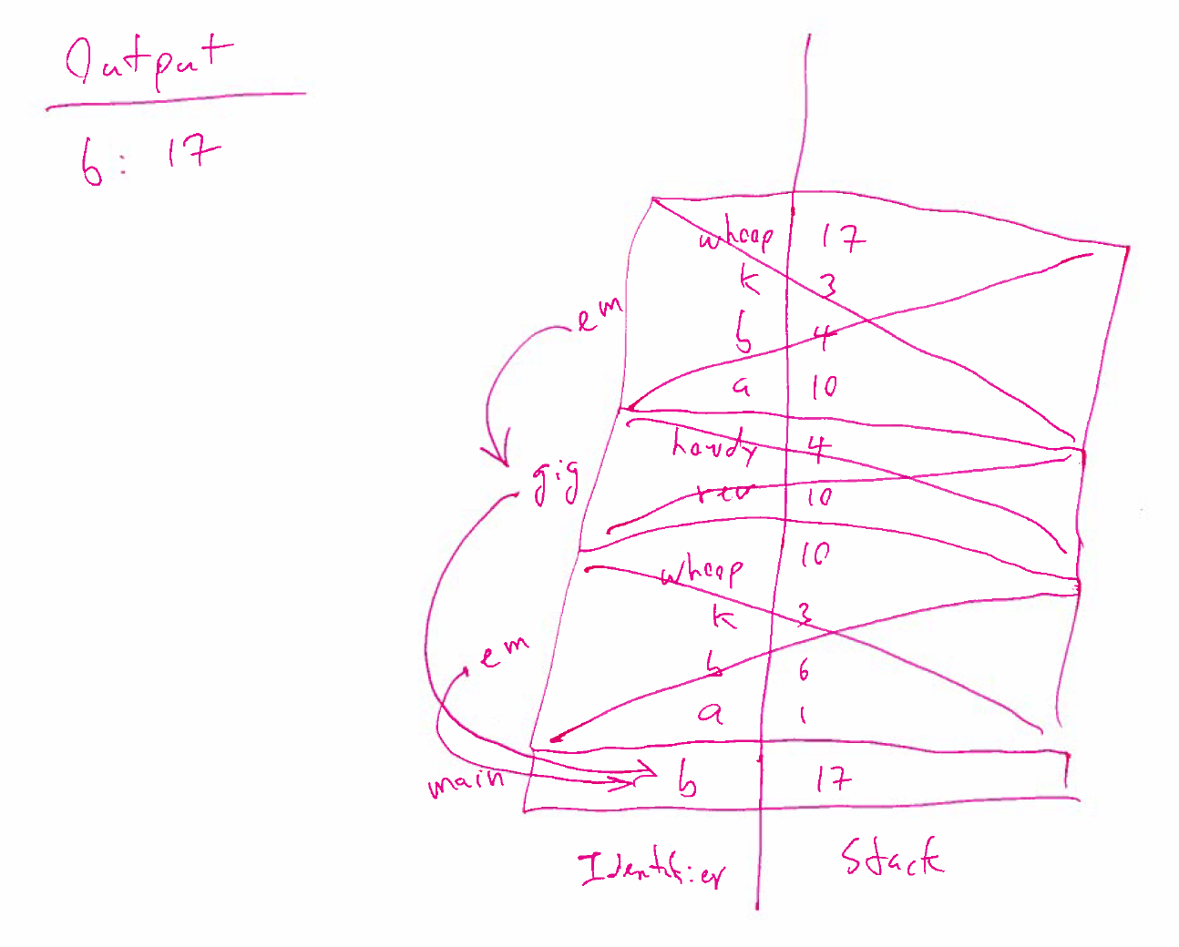

Slide 48
Anatomy of a Function Part 2
CSCE 121
J. Michael Moore
Strongly influenced by slides created by Bjarne Stroustrup and Jennifer Welch

Slide 49
Recall References
Alternative name for an object
Can have multiple names referring to the same object (location in memory)
Once a reference is initialized, it cannot be changed to refer to a different object (i.e. location)
int i = 7;
int& r = i; // r is a reference to an int
r = 9; // i becomes 9

Slide 50
Pass by Reference (How)
In function declaration
Use “&” after the type to indicate that the formal argument should be passed by reference
int f(int& a) { a = a+1; return a; }
OR
int f(int &a) { a = a+1; return a; }
To call, same as call by value (i.e. what we did before)

Slide 51
Pass by Reference (Consequence)
Reference (stored as an address) is copied
Formal Argument is now a reference to the actual argument.
i.e. the variable corresponding to the formal argument in the function point to the same object (memory location) of the actual argument.
Actual argument can be changed in the function via the reference.
i.e. Changing the variable (passed by reference) in the function changes the variable used as an actual argument in the function call.

Slide 52
Pros: Pass by Reference
Recall that functions can only return a single value…
So, with pass by reference, multiple variables can be “returned” from a function.
Some objects can be very large.
E.g. a vector with a billion elements.
Do you really need to copy a billion elements just to do something like find a maximum?
So, passing by reference avoids overhead of copying very large arguments.

Slide 53
Cons: Pass by Reference
You really do not want to change the value of the actual argument.
If passed by reference, the function might inadvertently modify the actual argument.
This is a side effect. (Side effects tend to be bad things that we want to avoid!)
Regardless, this can result in obscure bugs that are difficult to track down.

Slide 54
Competing Challenges
What if we want to avoid copying large objects and also ensure there are no changes to the actual argument?
Recall, when a variable is declared const, then its value cannot be changed.
So the solution is to pass by const reference.

Slide 55
Pass by Const-Reference (How)
In function definition, write the formal argument like: const type& var (OR const type &var)
int f(const int& a) {
int b;
b = a+1;
return b;
}

Slide 56
Pros: Pass by Const-Reference
Useful to pass large objects that should not be changed.
Compiler will not allow changes to arguments passed by const-reference.
Or to any parameter with const associated with it.

Slide 57
Cons: Pass by Const-Reference
Accessing references is a bit slower than directly accessing the value.
Reference address is read from memory and then the value is read from the reference address. I.e. two steps.
Without reference, value can be accessed directly.
For small objects:
The address will be copied. A small object’s value can be copied (pass by value) just as quickly as an address can be copied (pass by reference).
For large objects:
The savings in not copying far outweighs the slower access.

Slide 58
Guidelines for Passing Arguments
Better to make a change by returning a result instead of modifying an object through an argument.
Preferred for changing ‘z’
z = change(z);
change is either pass by value or pass by const-reference
Return value is copied over the original value
Avoid
change(z);
change is pass by reference
z‘s value is changed in the function

Slide 59
Guidelines for Passing Arguments
Use pass by value for small objects, e.g. any simple data type (int, double, char) and strings
Use pass by const-reference for large objects, e.g. vectors, classes
Use pass-by-reference only when you have to

Slide 60
What is a large object?
Vectors
zyBooks says you should pass by reference when a vector grows beyond 10 items.
What if it is 10 really large items?
What if we thought is would only be 10, but grows more than expected?
I recommend using pass by const-reference anytime you use a vector in this class.
Strings
Generally they stay small, so can pass by value.
One single spaced typed page is only about 3000 characters which is quite small, even if 1000 pages.
However, they can grow very large.
Max size is on the order of four trillion characters.
Be aware and pass by const-reference when needed.
I recommend using pass by value anytime you use a string in this class.

Slide 61
const Woes
Is remembering when to use const challenging you?
Try this:
Use const for everything.
Then remove const when you need to.
Note:
Using const by value is not any safer for protecting calling variable.
It does prevent you from changing the variable created during the function call.

Slide 62
How Functions Work Part 2
CSCE 121
J. Michael Moore

Slide 63
Memory Diagram
How do references affect the memory diagram.
References store an address.
Rather than worry about a particular number:
Use a small circle to indicate the value is an address.
Use an arrow from the circle that points to the location/address.

Slide 64
Program
int mi(int j) {
int i = 5;
return j % i;
}
int re(int& s, int p) {
s = 12;
return mi(s*p);
}
int doe(int w) {
int k = 2;
int q = w+3;
cout << "k: " << k << endl;
int z = re(k, q);
cout << "k: " << k << endl;
return z + w;
}
int main() {
int b = doe(11);
cout << "b: " << b << endl;
}

Slide 65
main
output
int main() {
int b = doe(11);
cout << "b: " << b << endl;
}
identifier
stack

Slide 66
main
output
int main() {
int b = doe(11);
cout << "b: " << b << endl;
}
main
b
identifier
stack

Slide 67
doe
output
k: 2
int doe(int w) {
int k = 2;
int q = w+3;
cout << "k: " << k << endl;
int z = re(k, q);
cout << "k: " << k << endl;
return z + w;
}
z
q
14
doe
k
2
w
11
main
b
identifier
stack

Slide 68
re
output
k: 5
int re(int& s, int p) {
s = 12;
return mi(s*p);
}
p
14
re
s
z
q
14
doe
k
2
12
w
11
main
b
identifier
stack

Slide 69
mi
output
k: 5
int mi(int j) {
int i = 5;
return j % i;
}
mi
i
5
j
168
3
p
2
re
s
z
q
14
doe
k
2
12
w
11
main
b
identifier
stack

Slide 70
re
output
k: 5
int re(int& s, int p) {
s = 12;
return mi(s*p);
}
mi
i
7
j
24
3
p
2
re
s
3
z
q
14
doe
k
2
12
w
11
main
b
identifier
stack

Slide 71
doe
output
k: 5
k: 12
int doe(int w) {
int k = 2;
int q = w+3;
cout << "k: " << k << endl;
int z = re(k, q);
cout << "k: " << k << endl;
return z + w;
}
mi
i
7
j
24
3
p
2
re
s
3
z
3
q
14
doe
k
2
12
14
w
11
main
b
identifier
stack

Slide 72
main
output
k: 5
k: 12
b: 14
int main() {
int b = doe(11);
cout << "b: " << b << endl;
}
mi
i
7
j
24
3
p
2
re
s
3
z
3
q
14
doe
k
2
12
14
w
11
main
b
14
identifier
stack

Slide 73
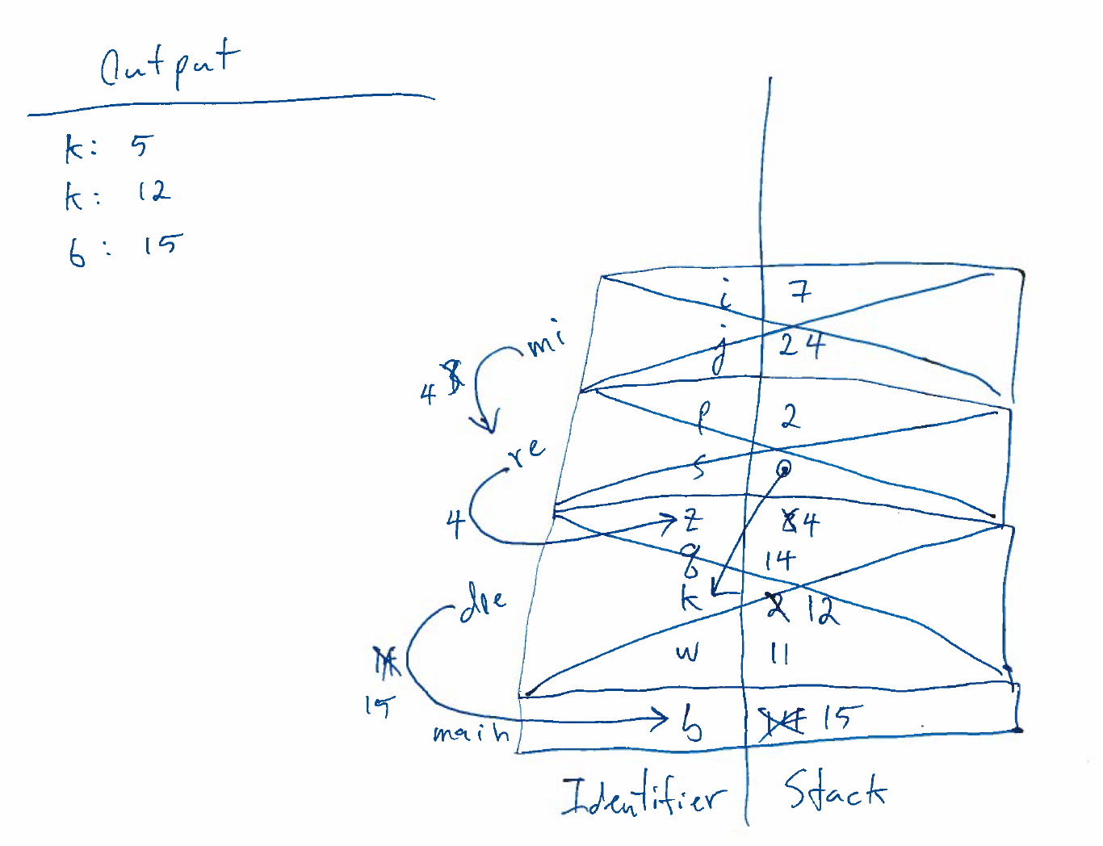

Slide 74
Command Line Parameters
CSCE 121
J. Michael Moore

Slide 75
Passing parameters to Programs
Happens all the time
Double click filename

Slide 76
Things to remember
argc
Argument count
Total number of parameters (includes program name)
Separated by spaces.
How to input a string with a space?
argv
Argument values
Array with each argument as an element
argv[0] is ALWAYS the name of the program
Pointers involved, frequently easier to assign to a string and then use the string

Slide 77
Programmer defines rules
If arguments do not follow rules:
Output usage information (i.e. help/feedback)
Exit program
Don’t prompt for new data…
Use of command line parameters can be quite sophisticated
Flags
Provide specific information
Frequently prepended with a dash, e.g. –al
Unix/Linux command line

